Slide 1
SOCIAL COMMERCE:
MY JOURNEY
KATIE RODAN, M.D.

Slide 2

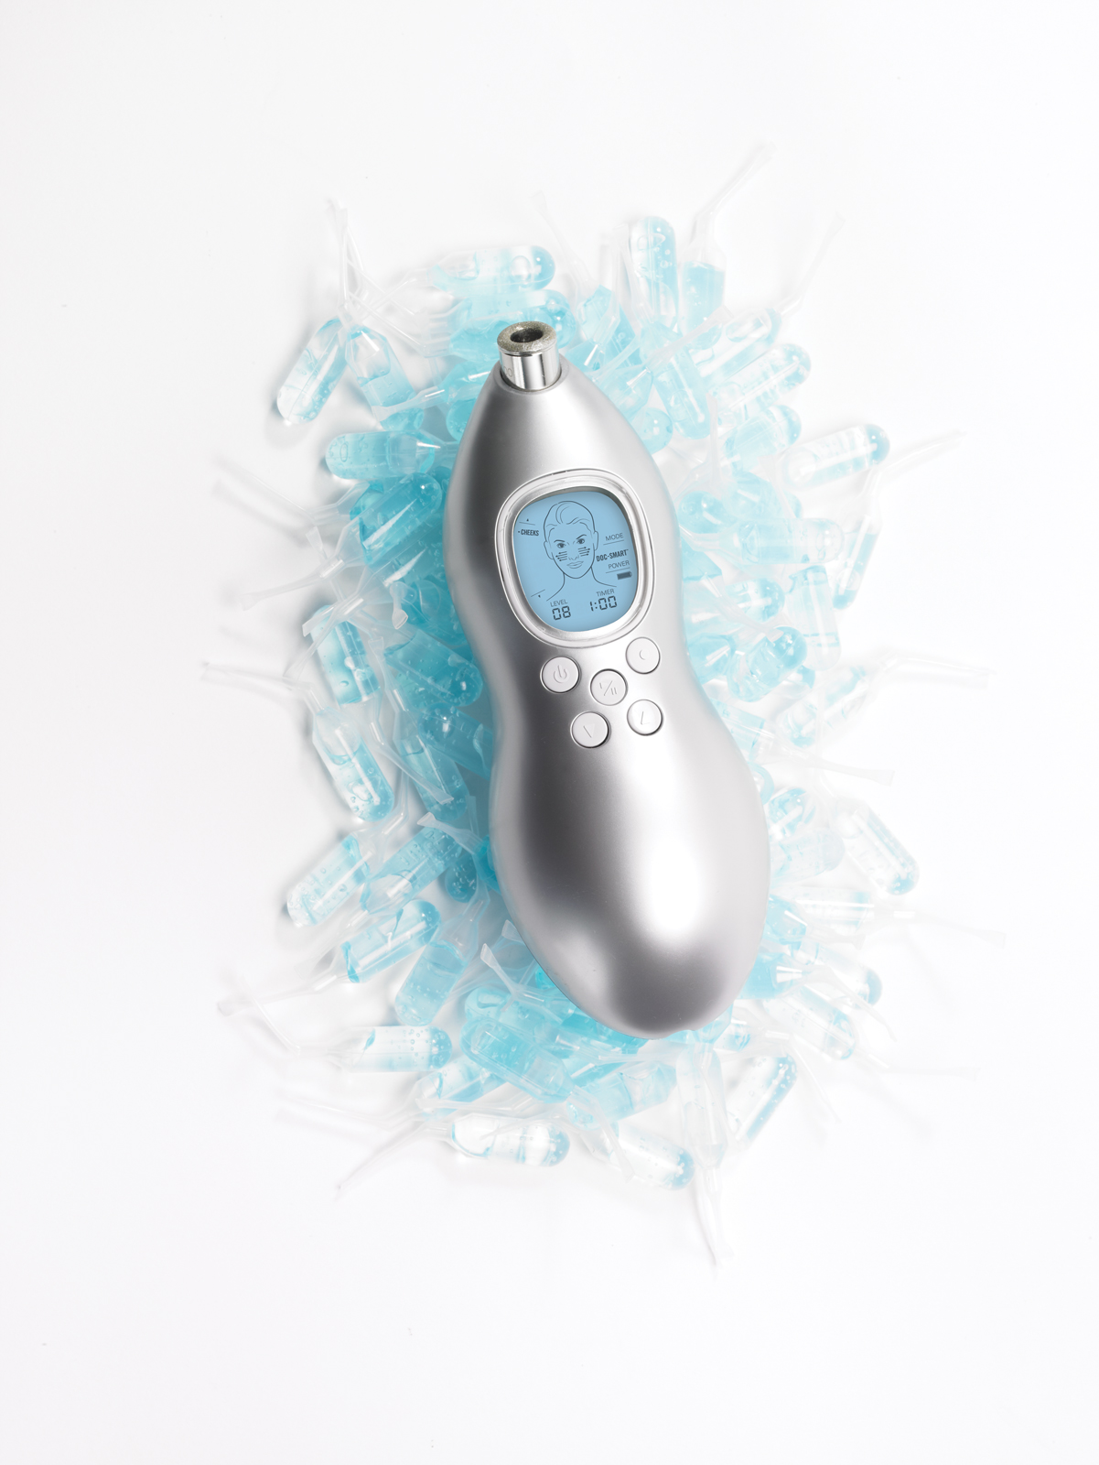

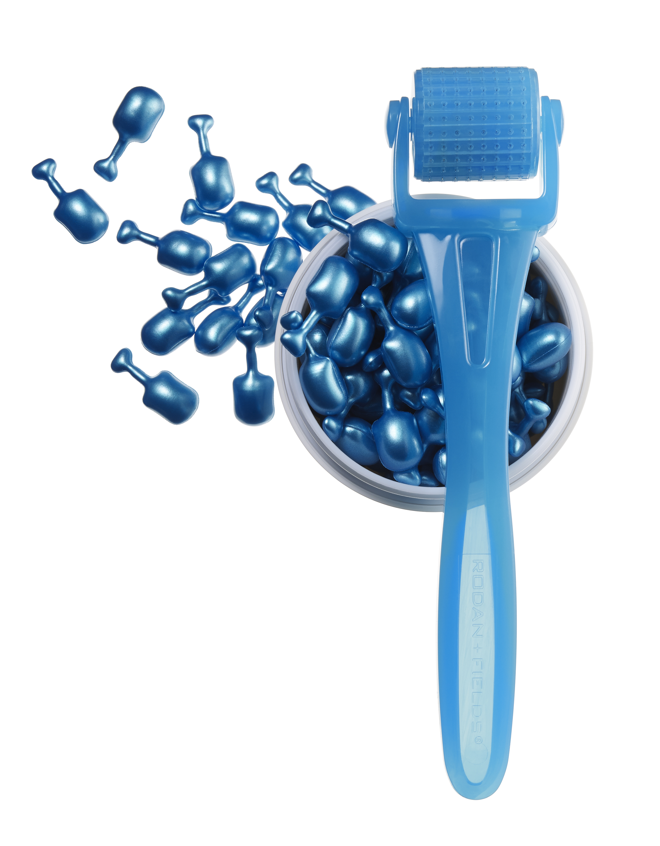
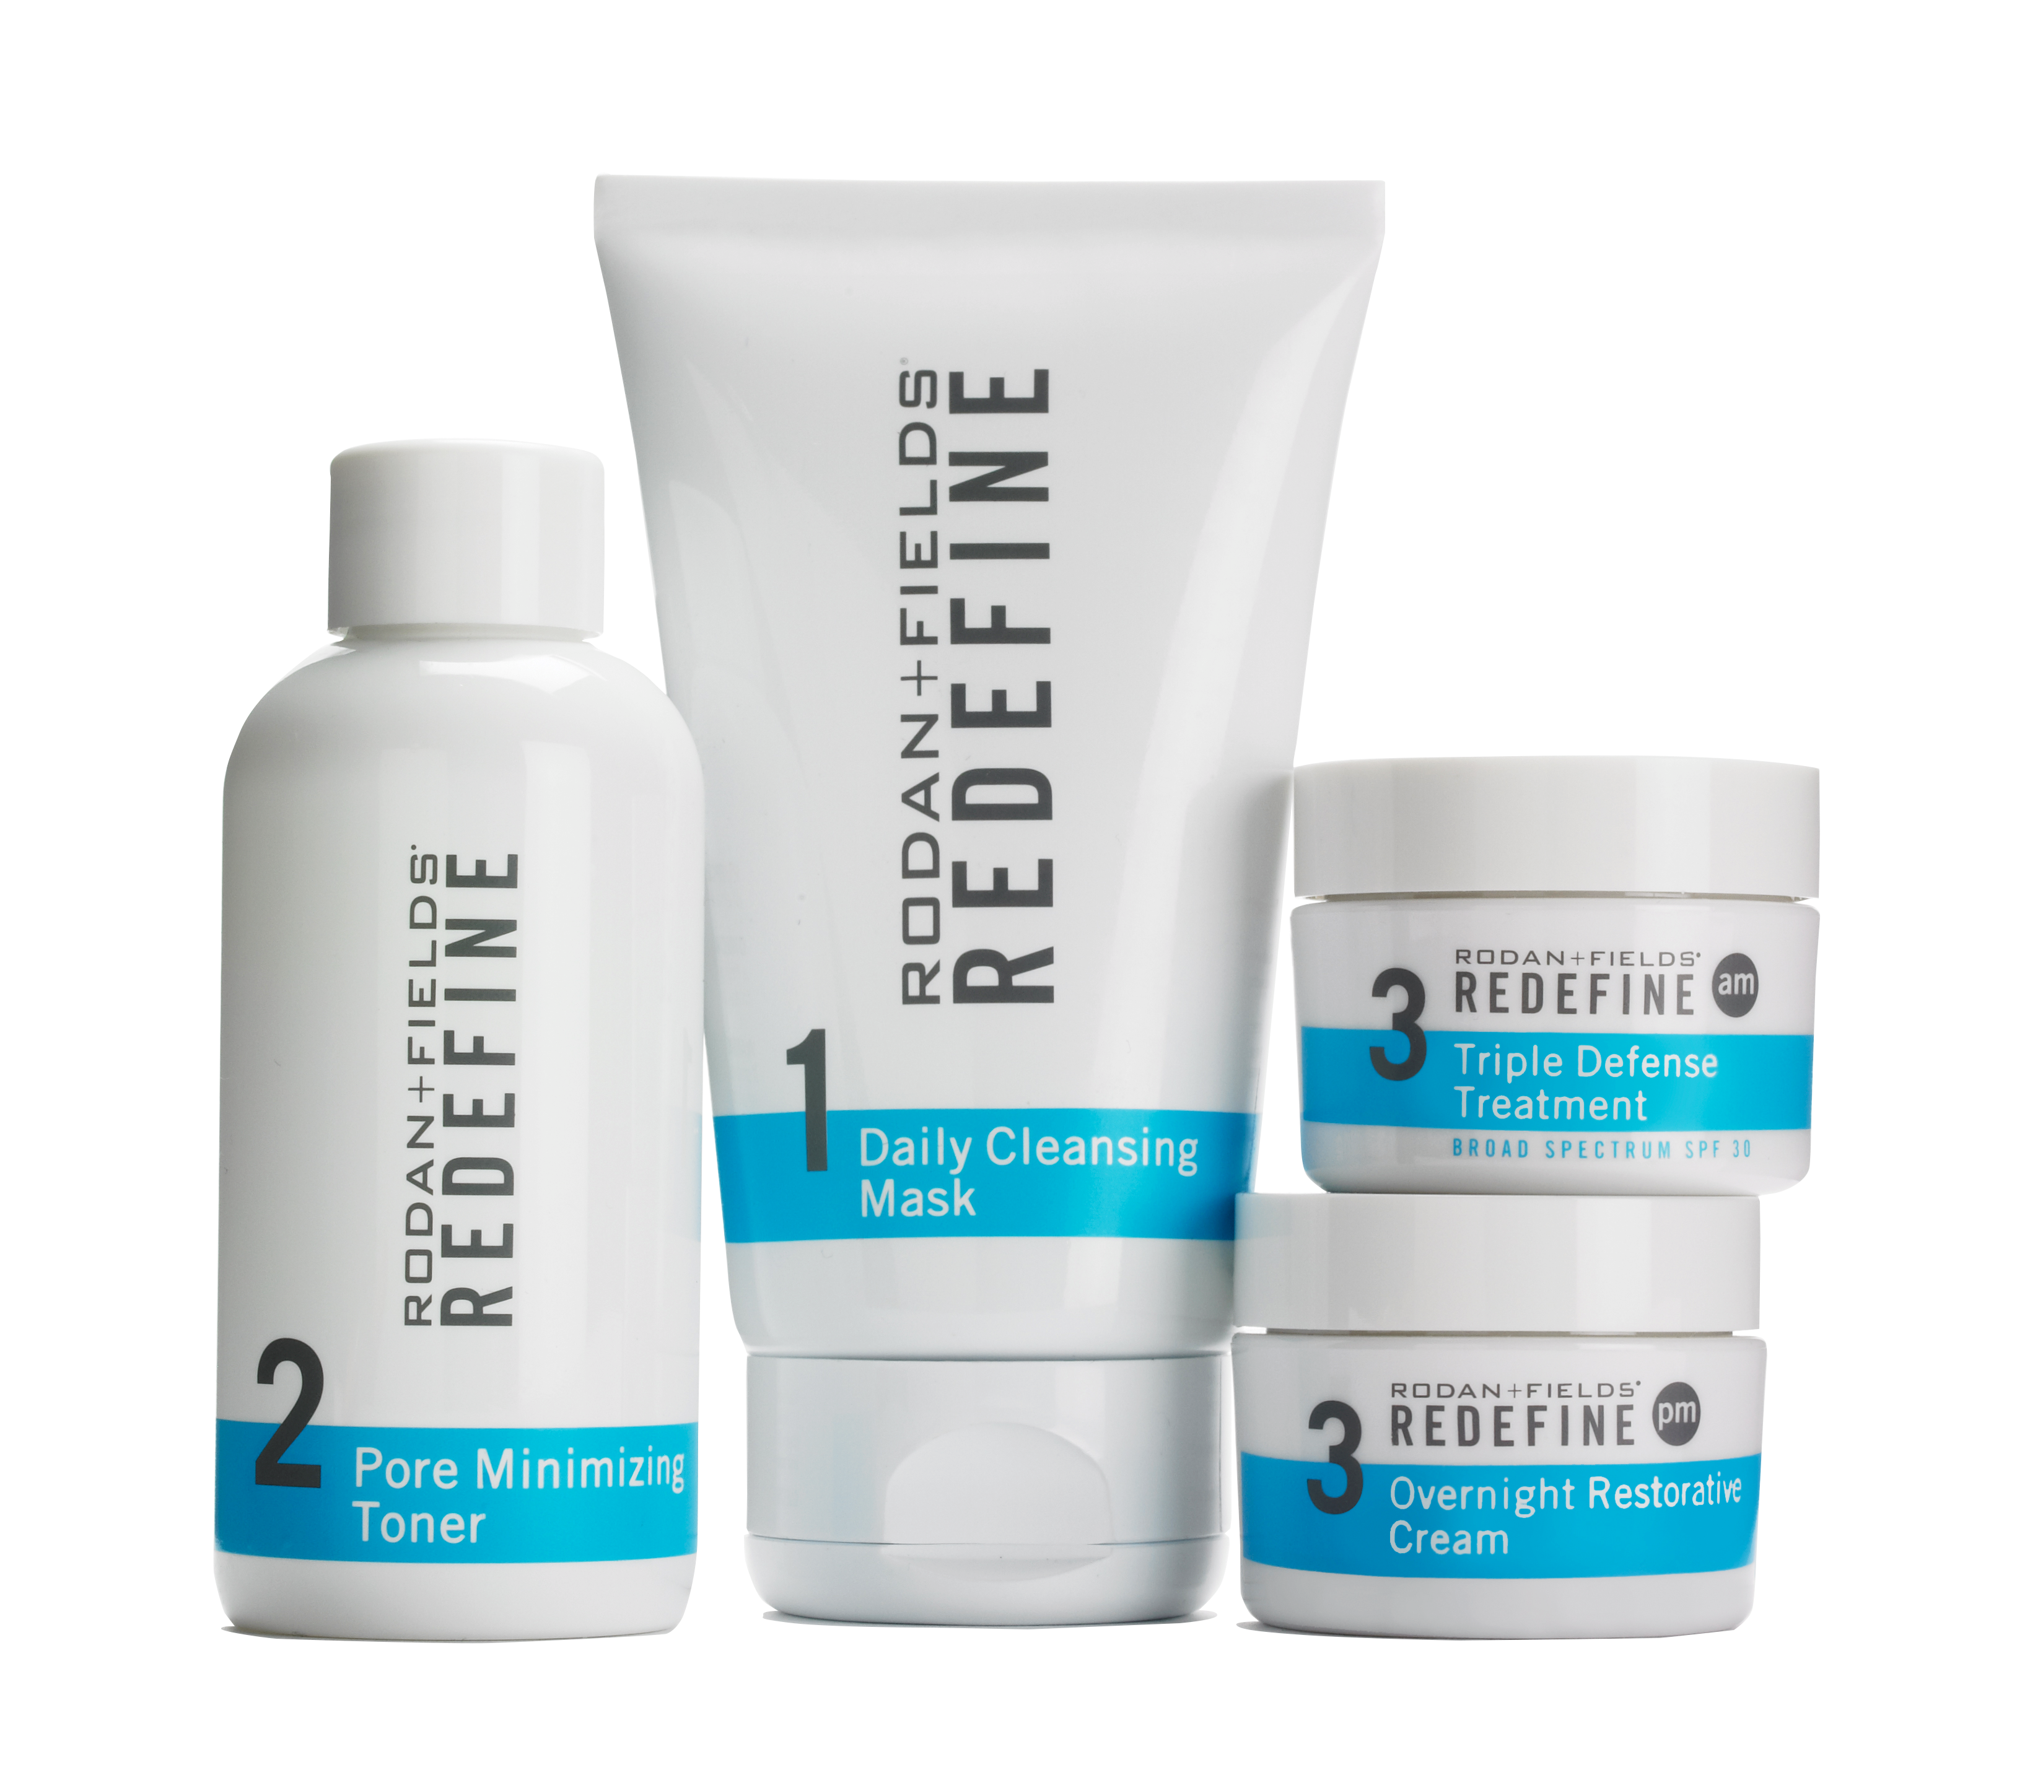

Slide 3
DNA
SOCIAL
COMMERCE
10 K
HOURS
DISRUPTIVE INNOVATION

Slide 4
DNA
SOCIAL
COMMERCE
0.0
10 K
HOURS
DISRUPTIVE INNOVATION

Slide 5
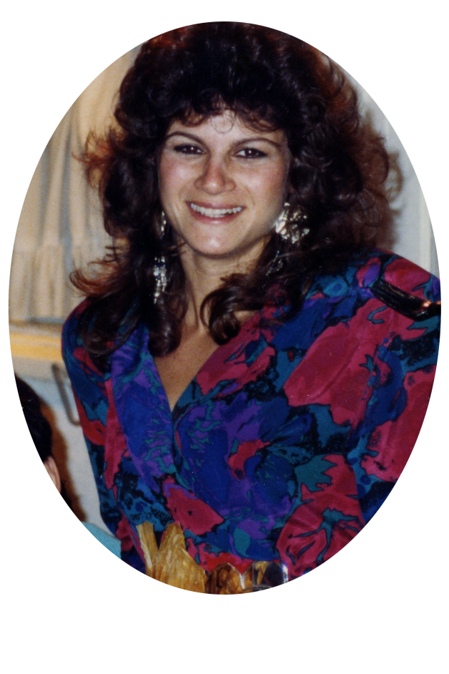

Slide 6
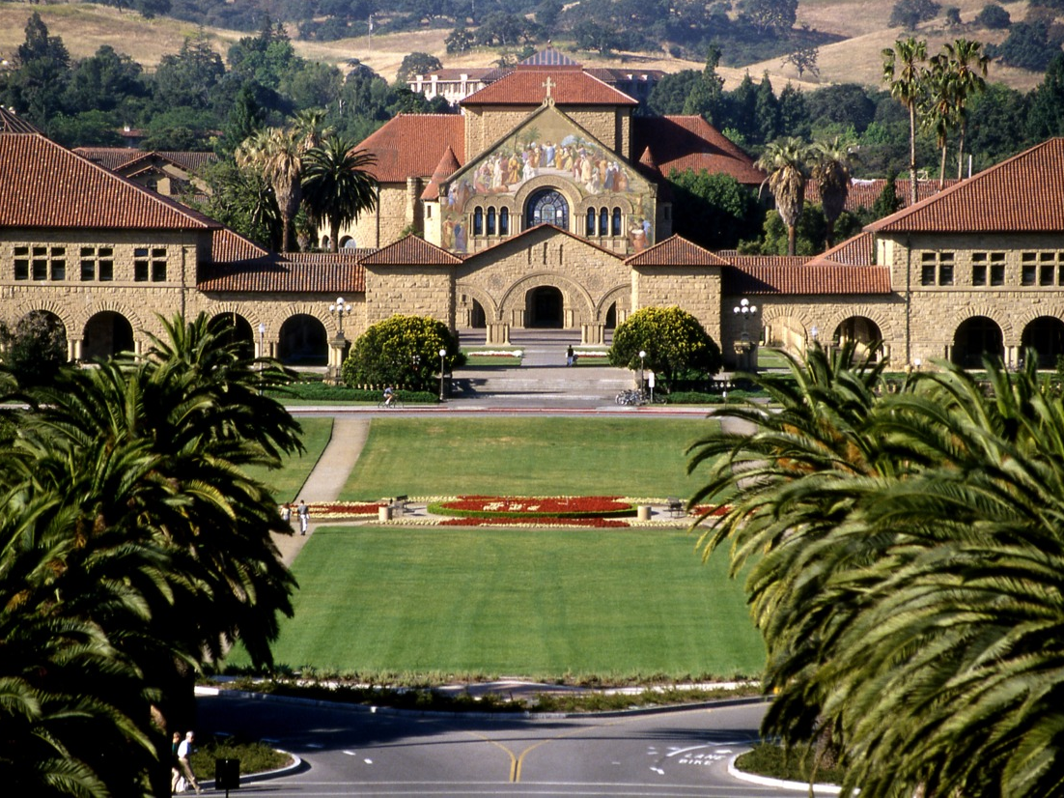
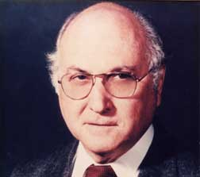

Slide 7
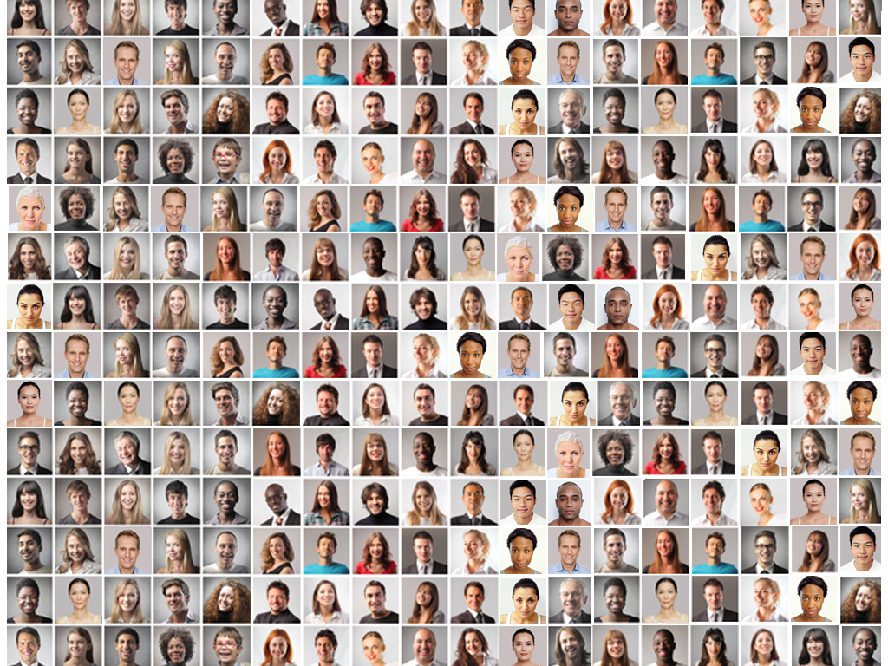

Slide 8
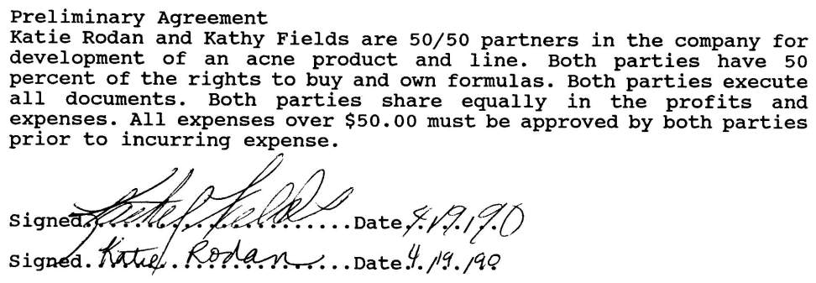

Slide 9
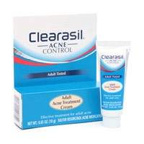
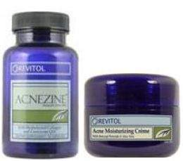
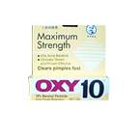
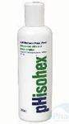
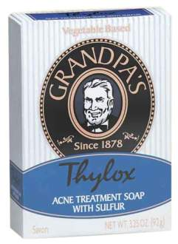
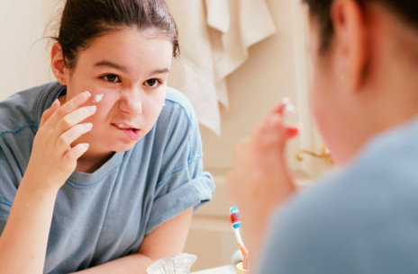
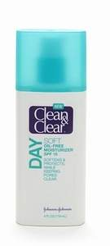
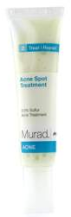
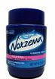
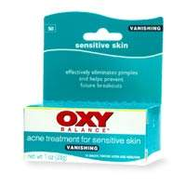
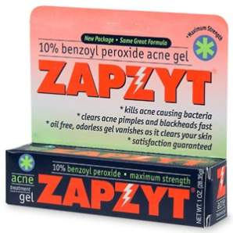

Slide 10
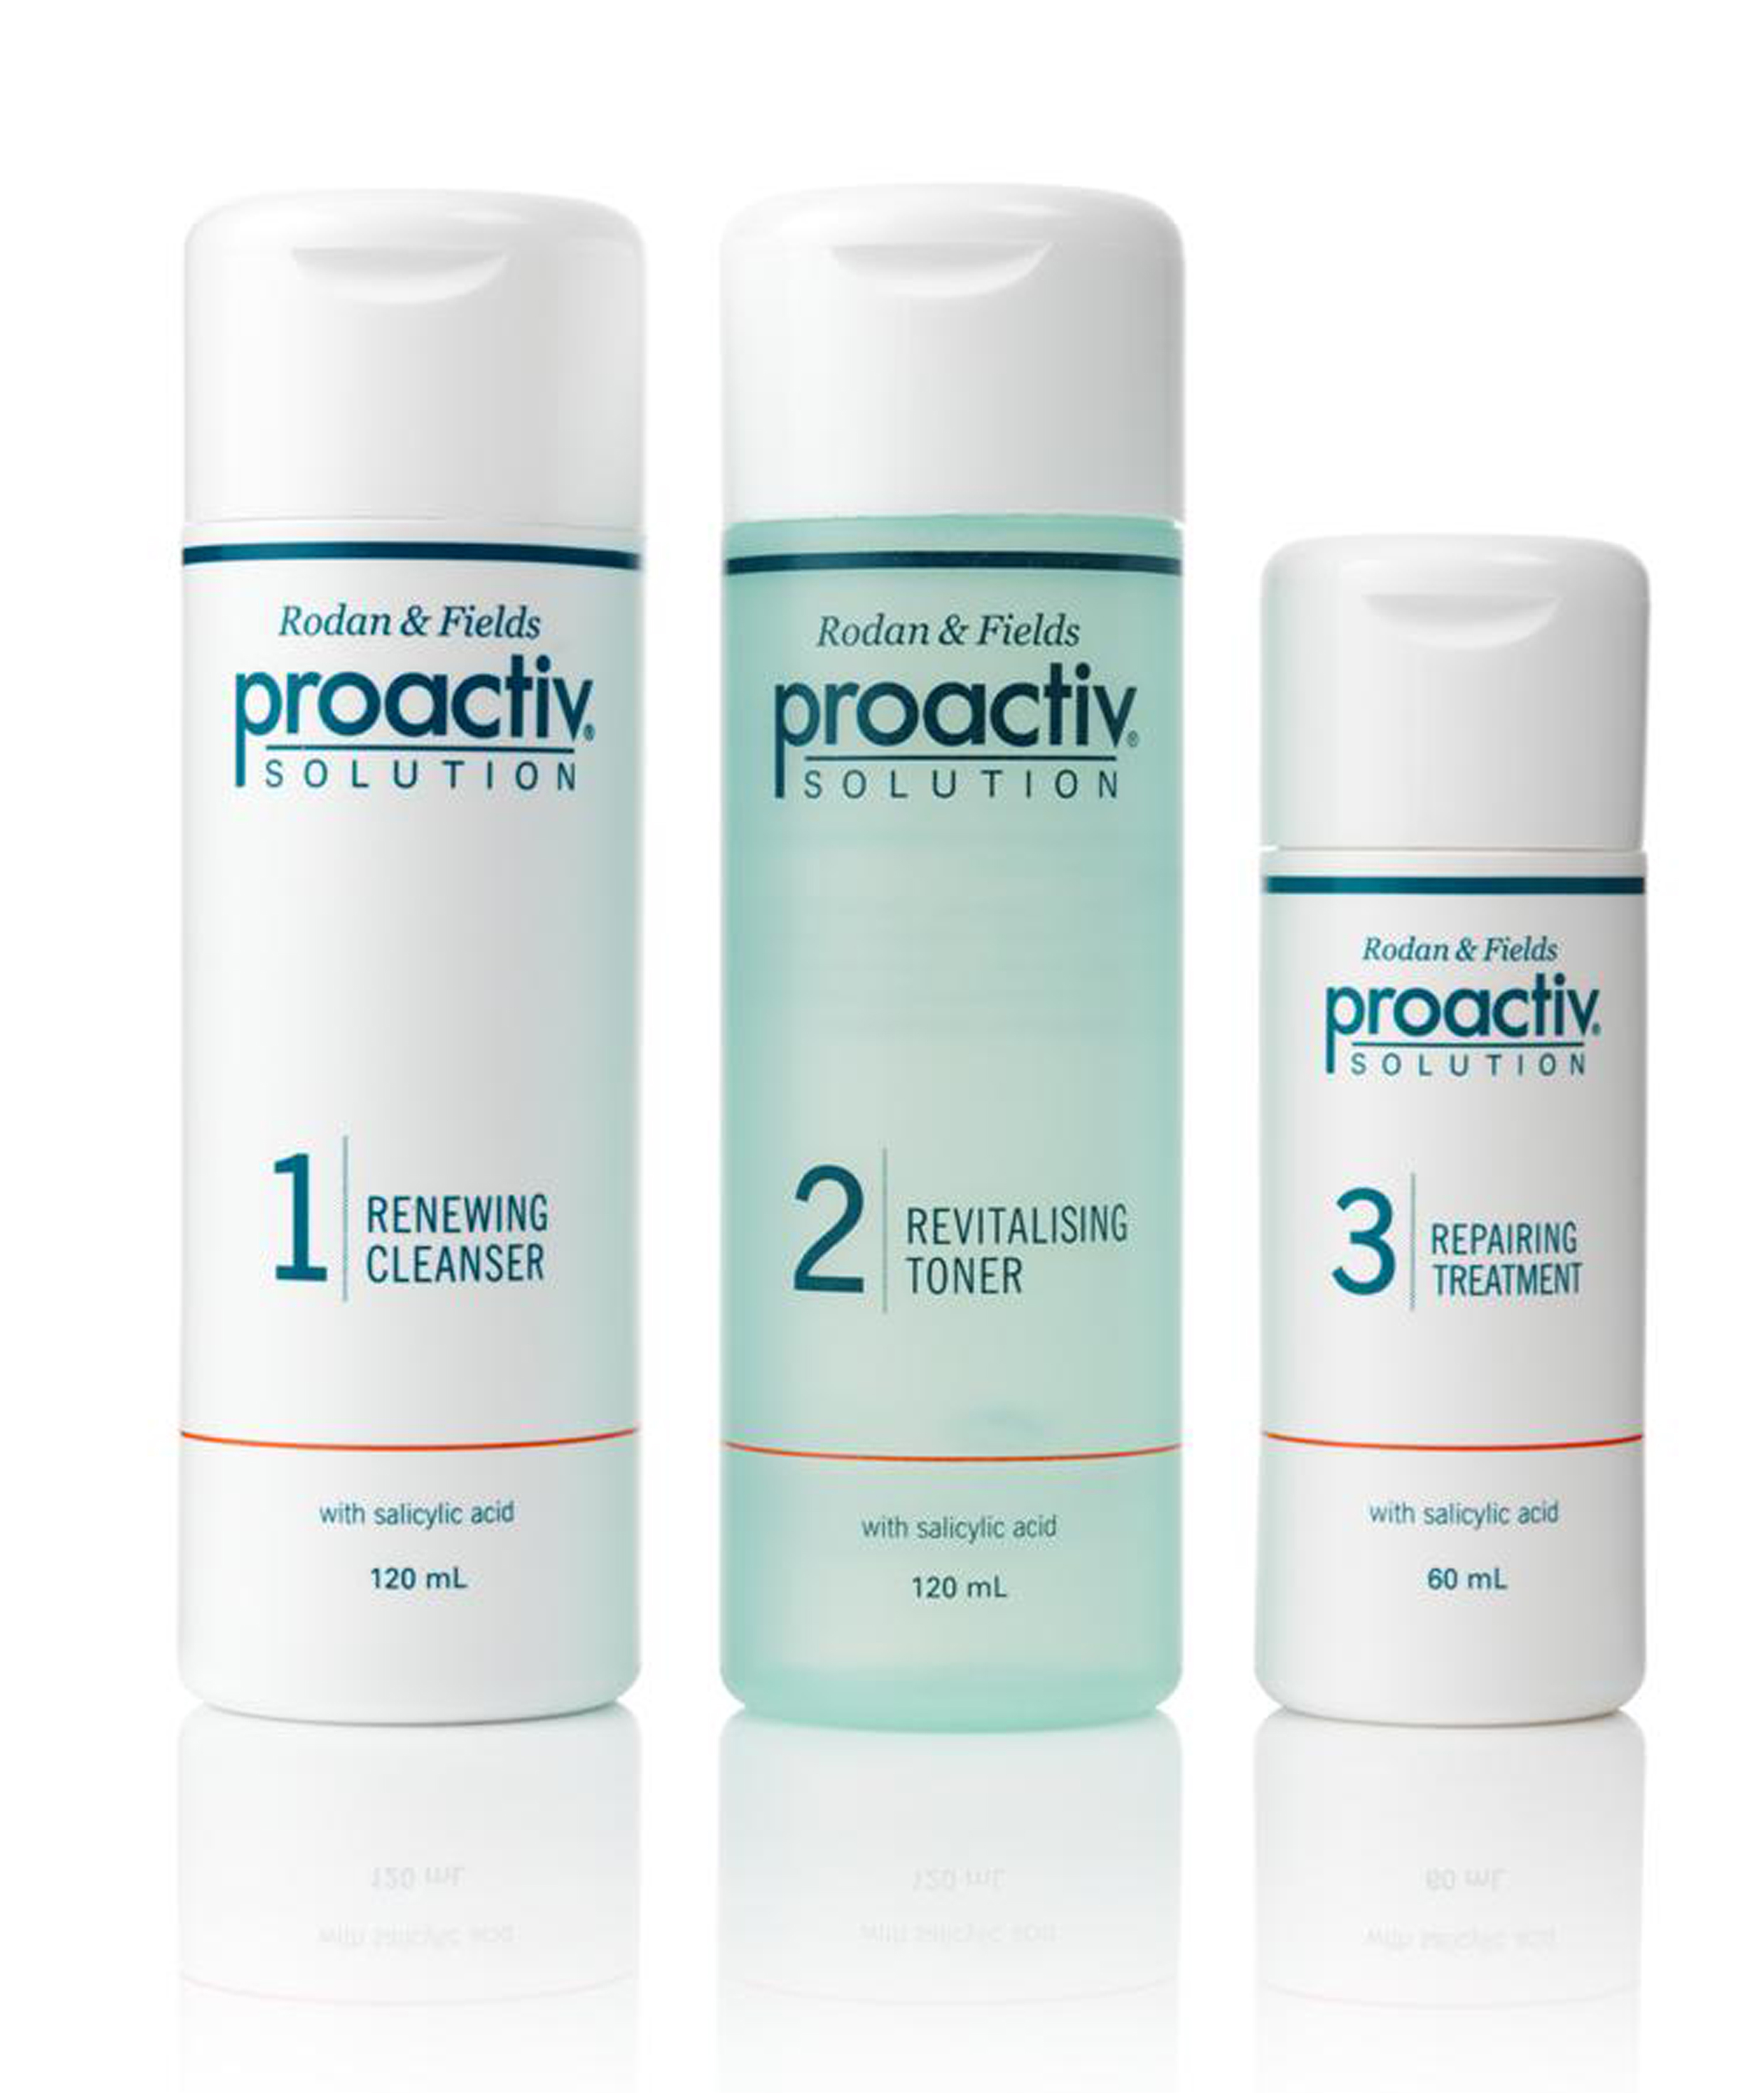


Slide 11
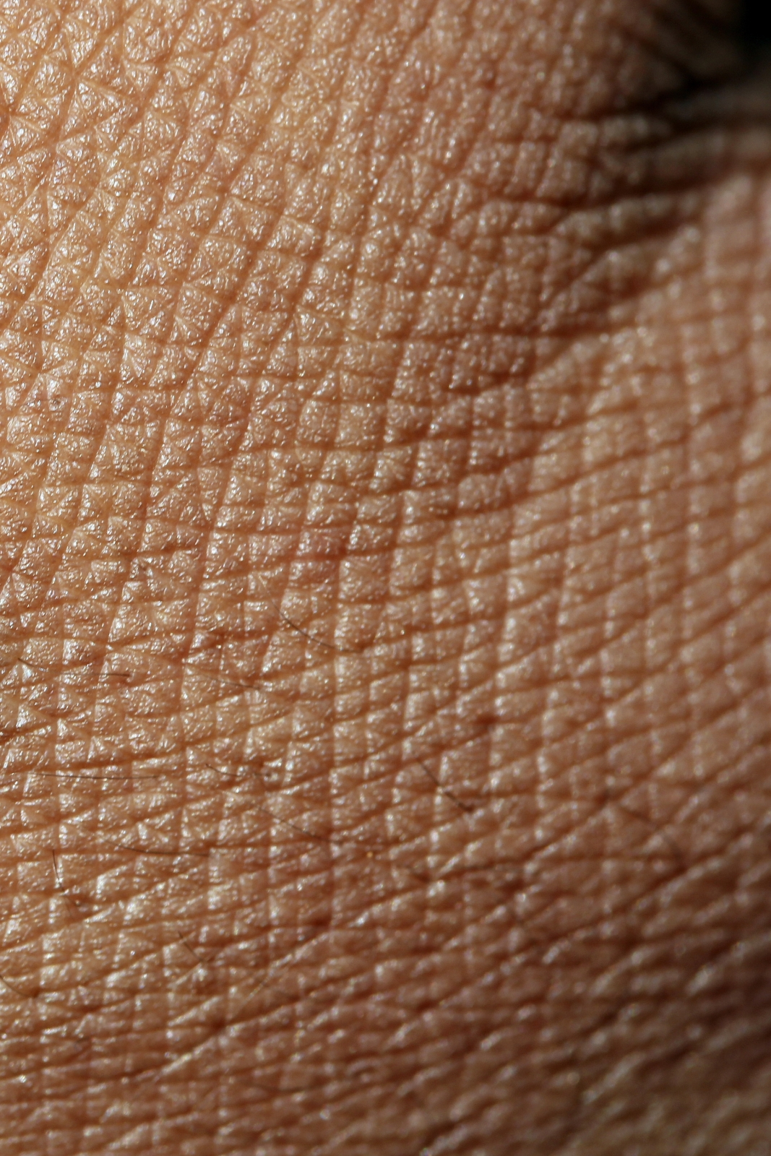
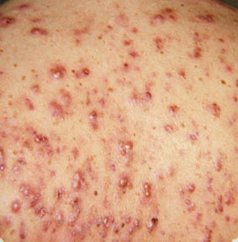
Skin Care
SKINCARE
ACNE

Slide 12
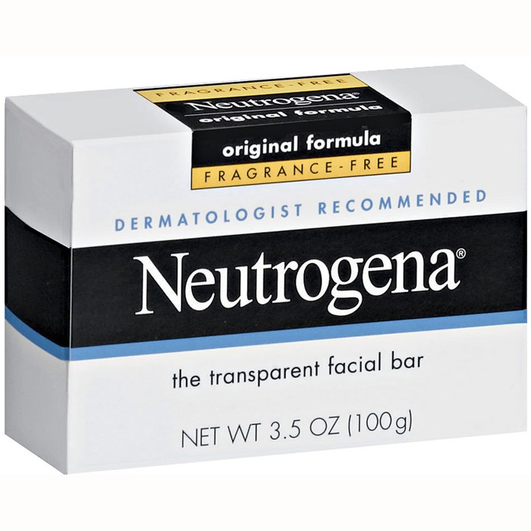
#1 Dermatologist
Recommended Brand

Slide 13



Slide 14
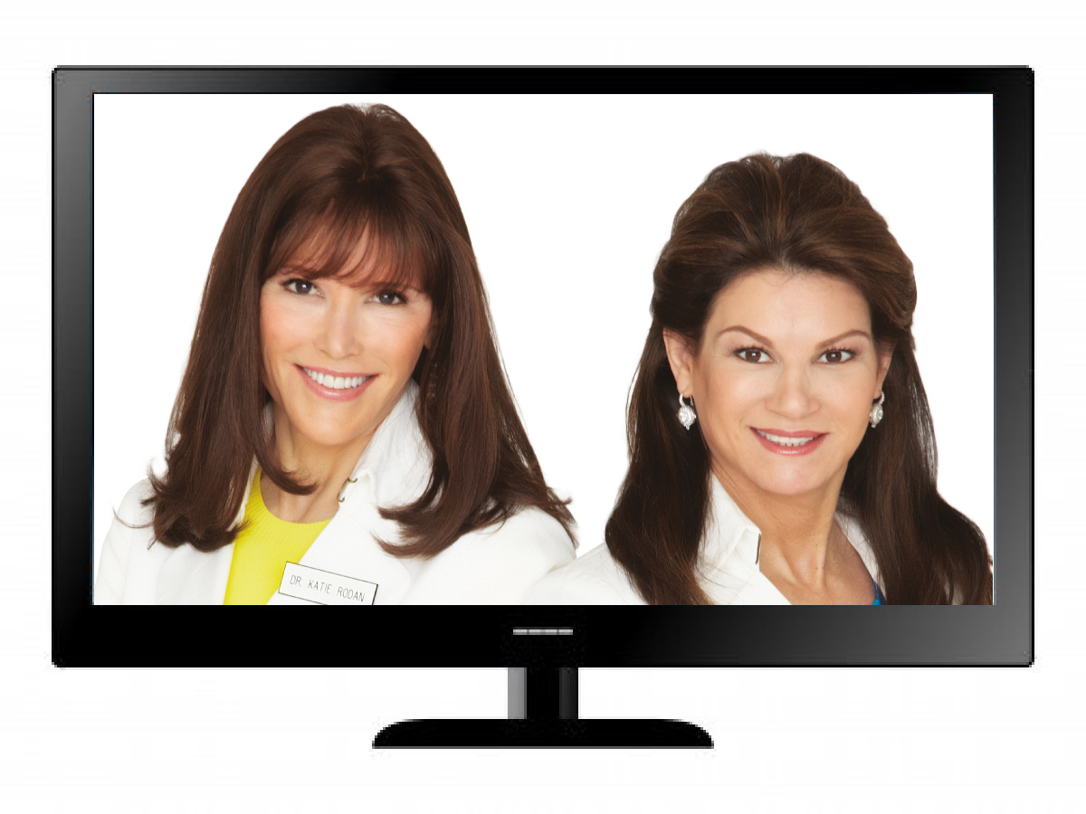
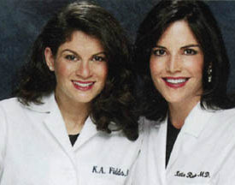

Slide 15


Slide 16
DNA
SOCIAL
COMMERCE
1.0
10 K
HOURS
DISRUPTIVE INNOVATION

Slide 17


Slide 18
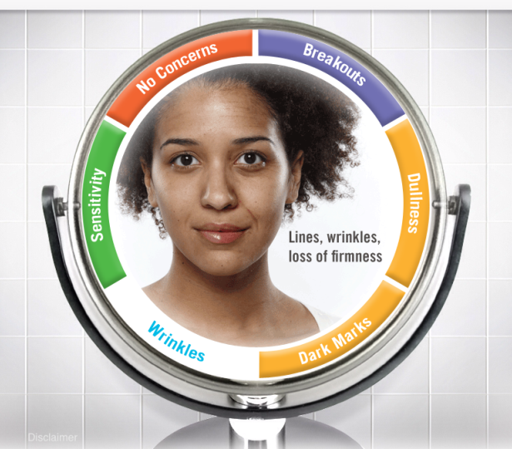
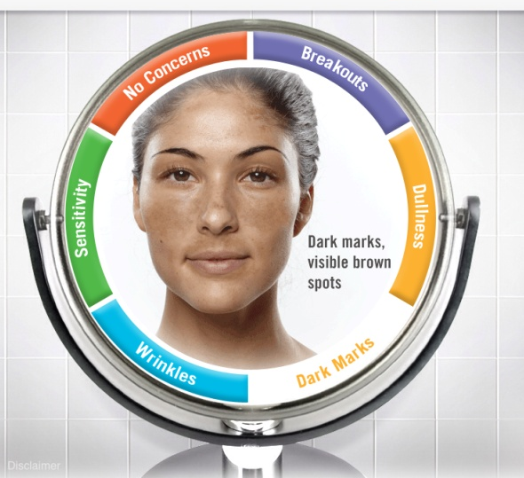
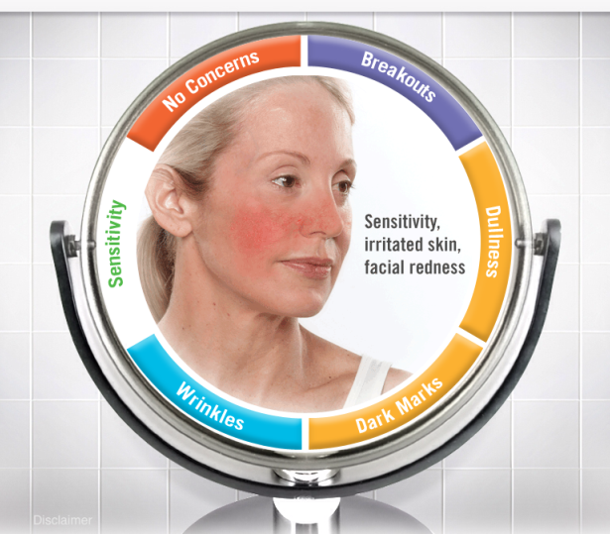
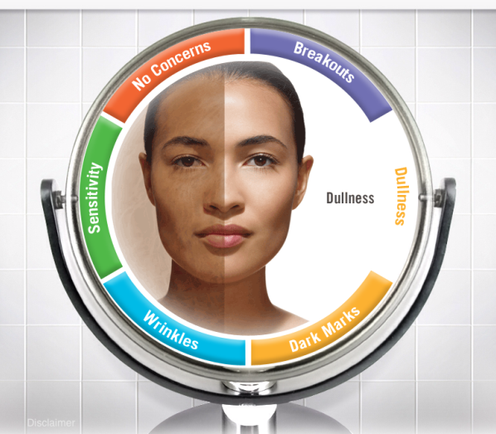
WRINKLES
DARKNESS
SENSITIVITY
DULLNESS

Slide 19
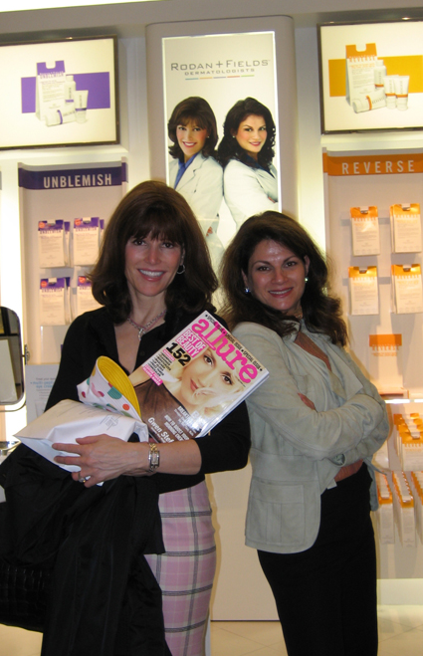

“
Lauder Signs
Deal For
Rodan + Fields
”
Women’s Wear Daily

Slide 20

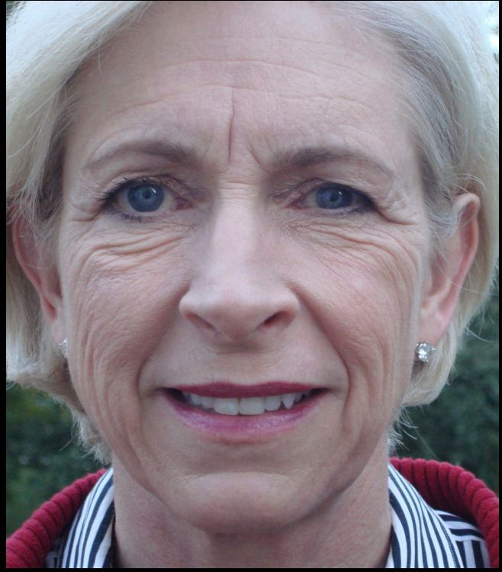
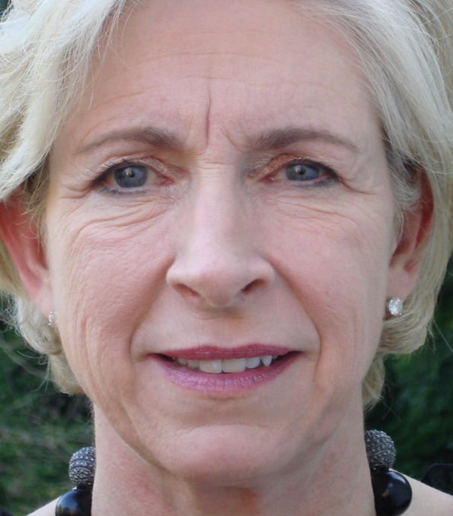
BEFORE
AFTER 9 MONTHS

Slide 21
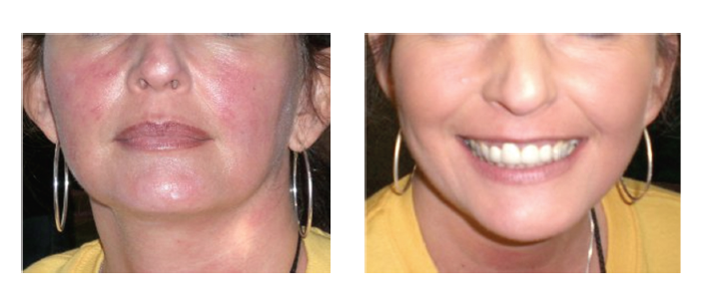
BEFORE
AFTER 5 WEEKS

Slide 22
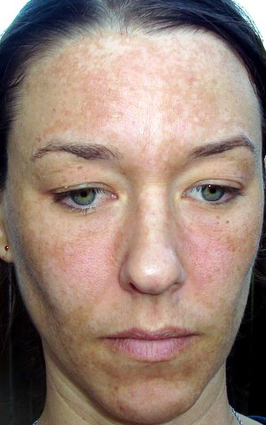
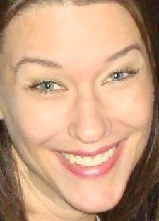
BEFORE
AFTER 75 DAYS

Slide 23
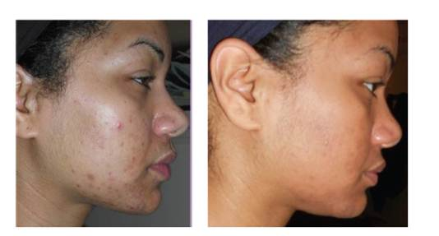
BEFORE
AFTER 8 WEEKS

Slide 24
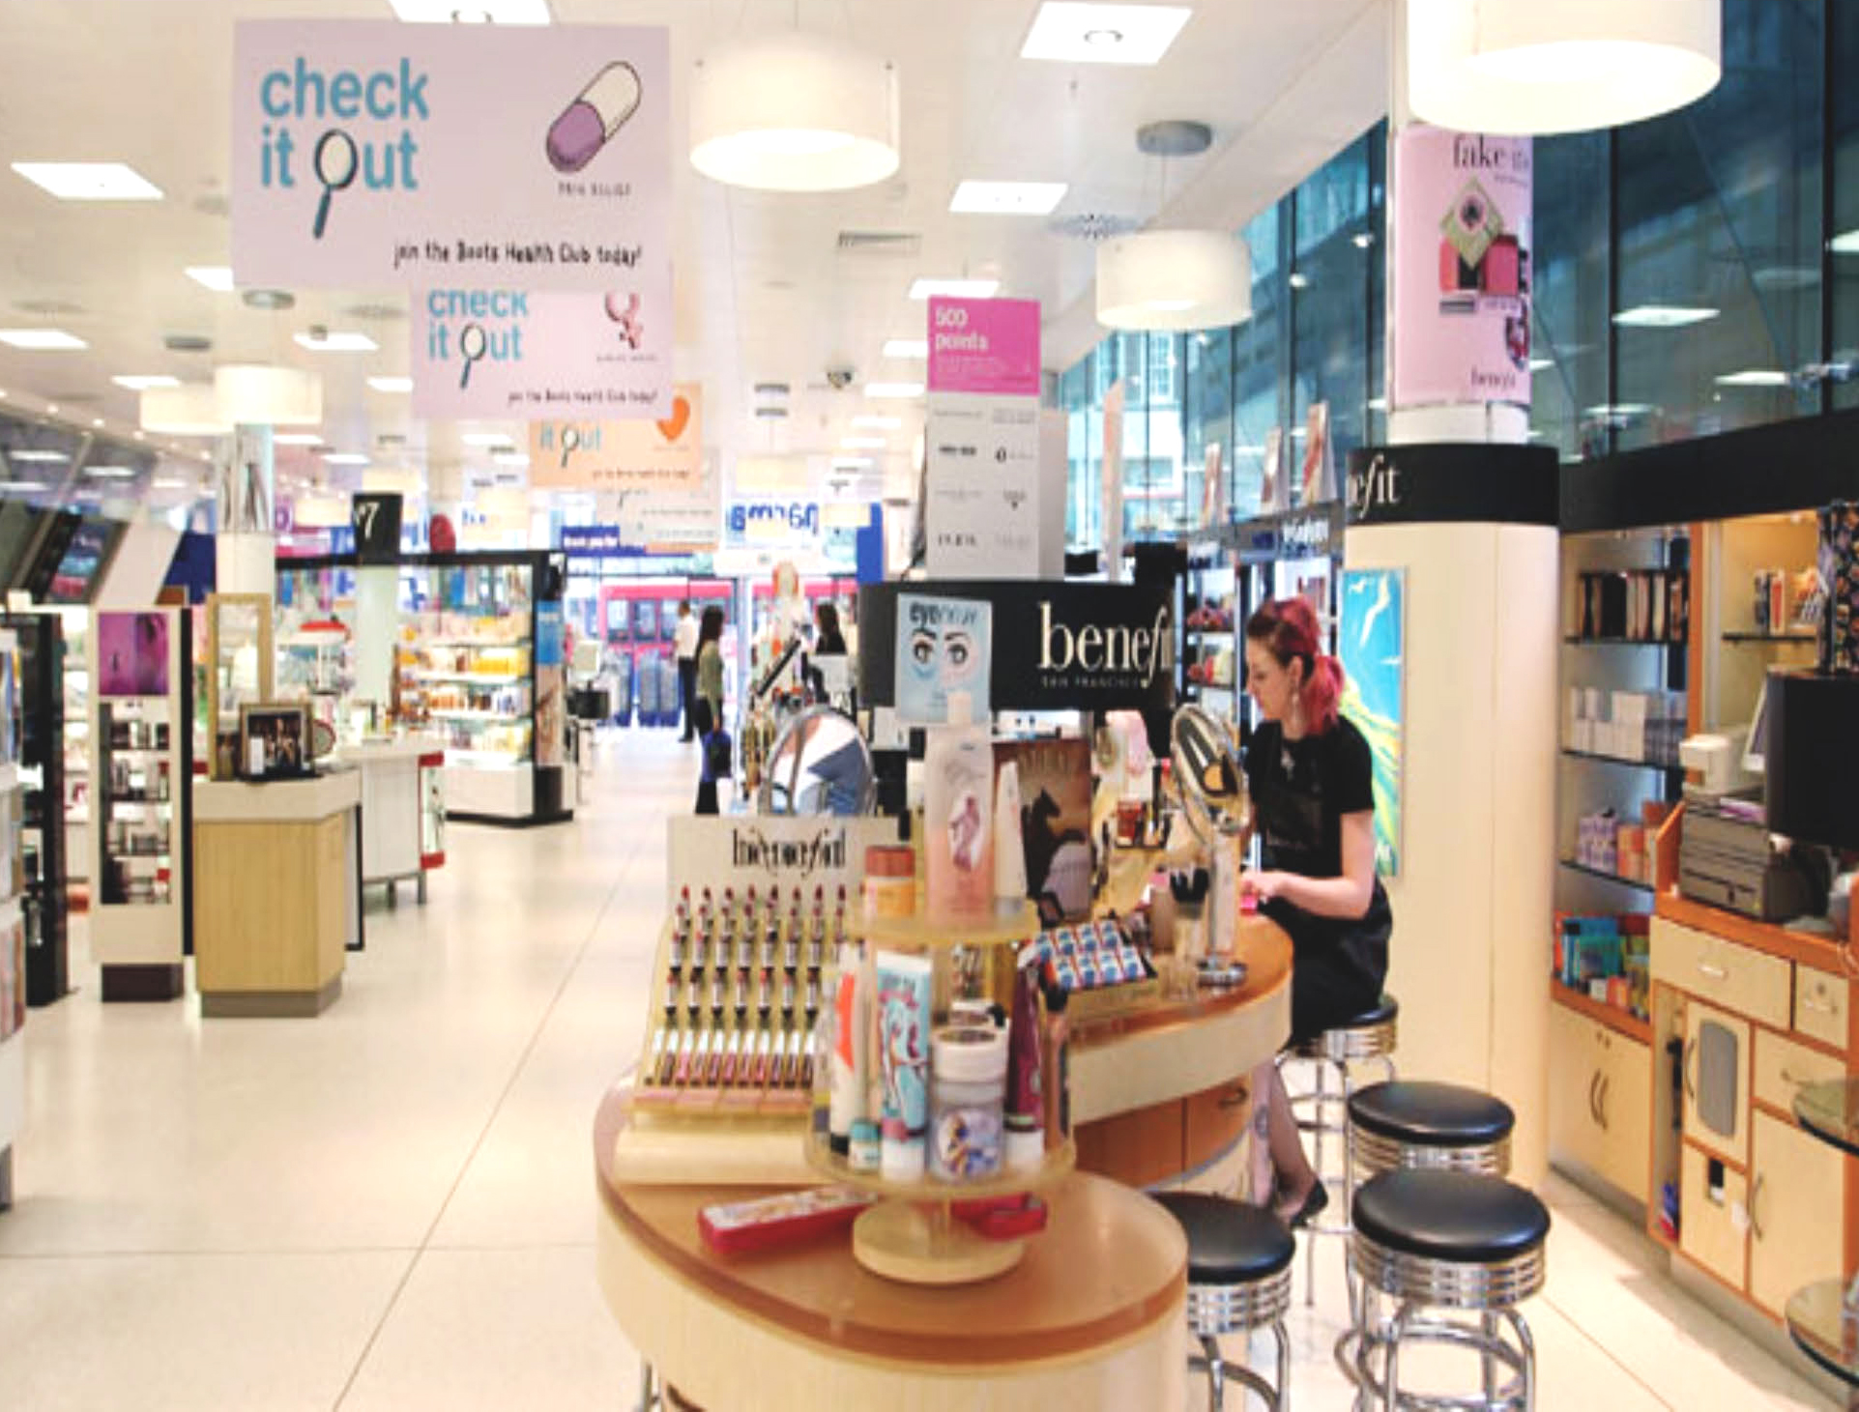

Slide 25
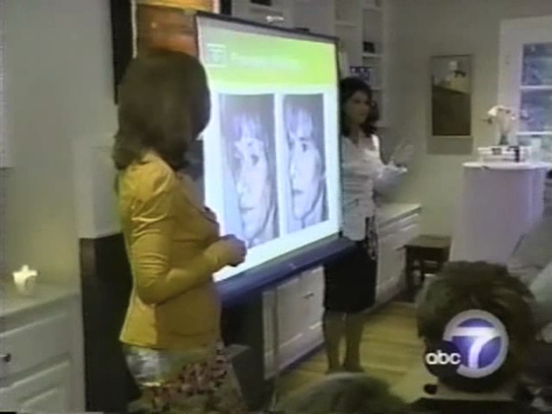

Slide 26
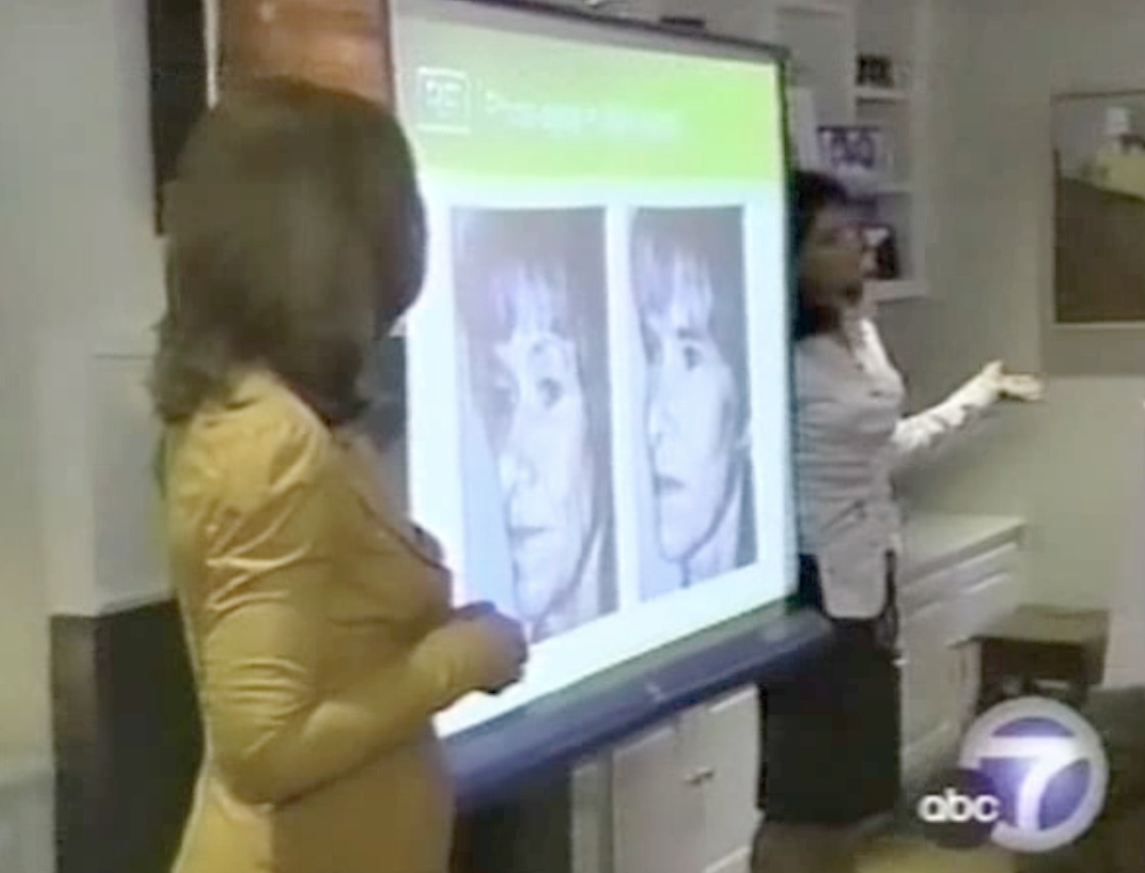

Slide 27

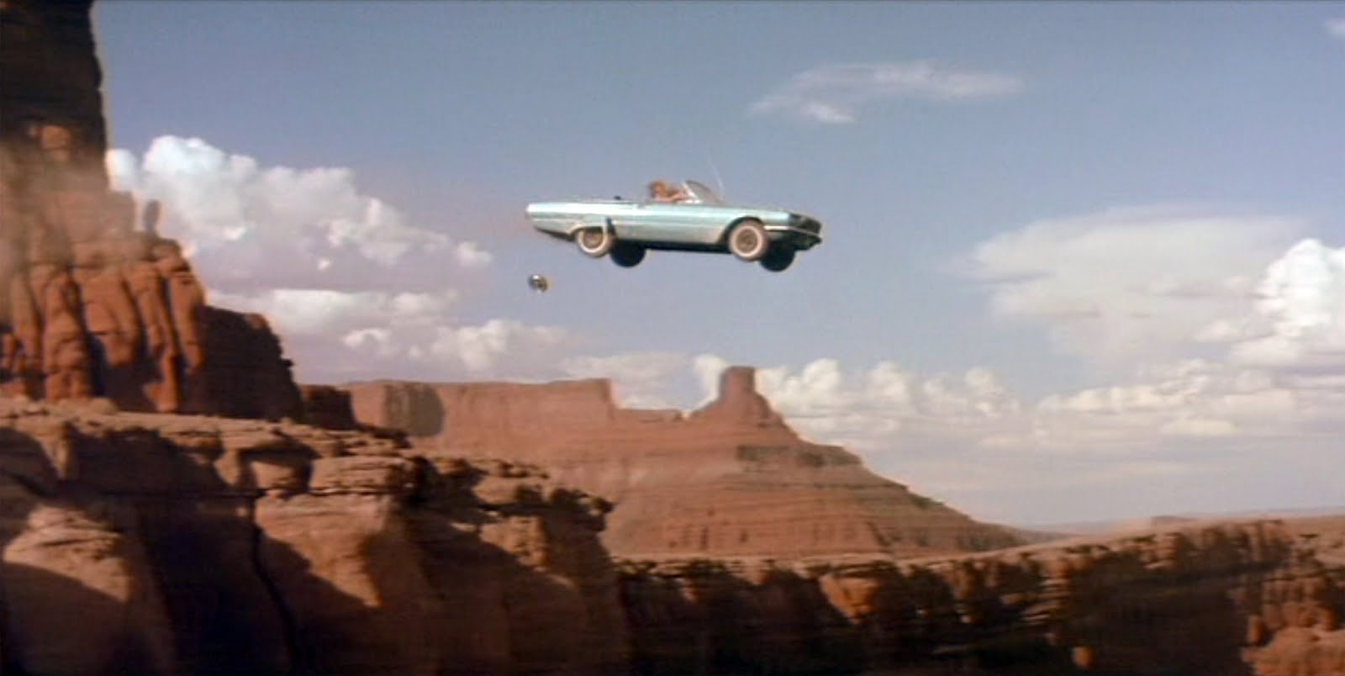

Slide 28
DNA
SOCIAL
COMMERCE
2.0
10 K
HOURS
DISRUPTIVE INNOVATION

Slide 29

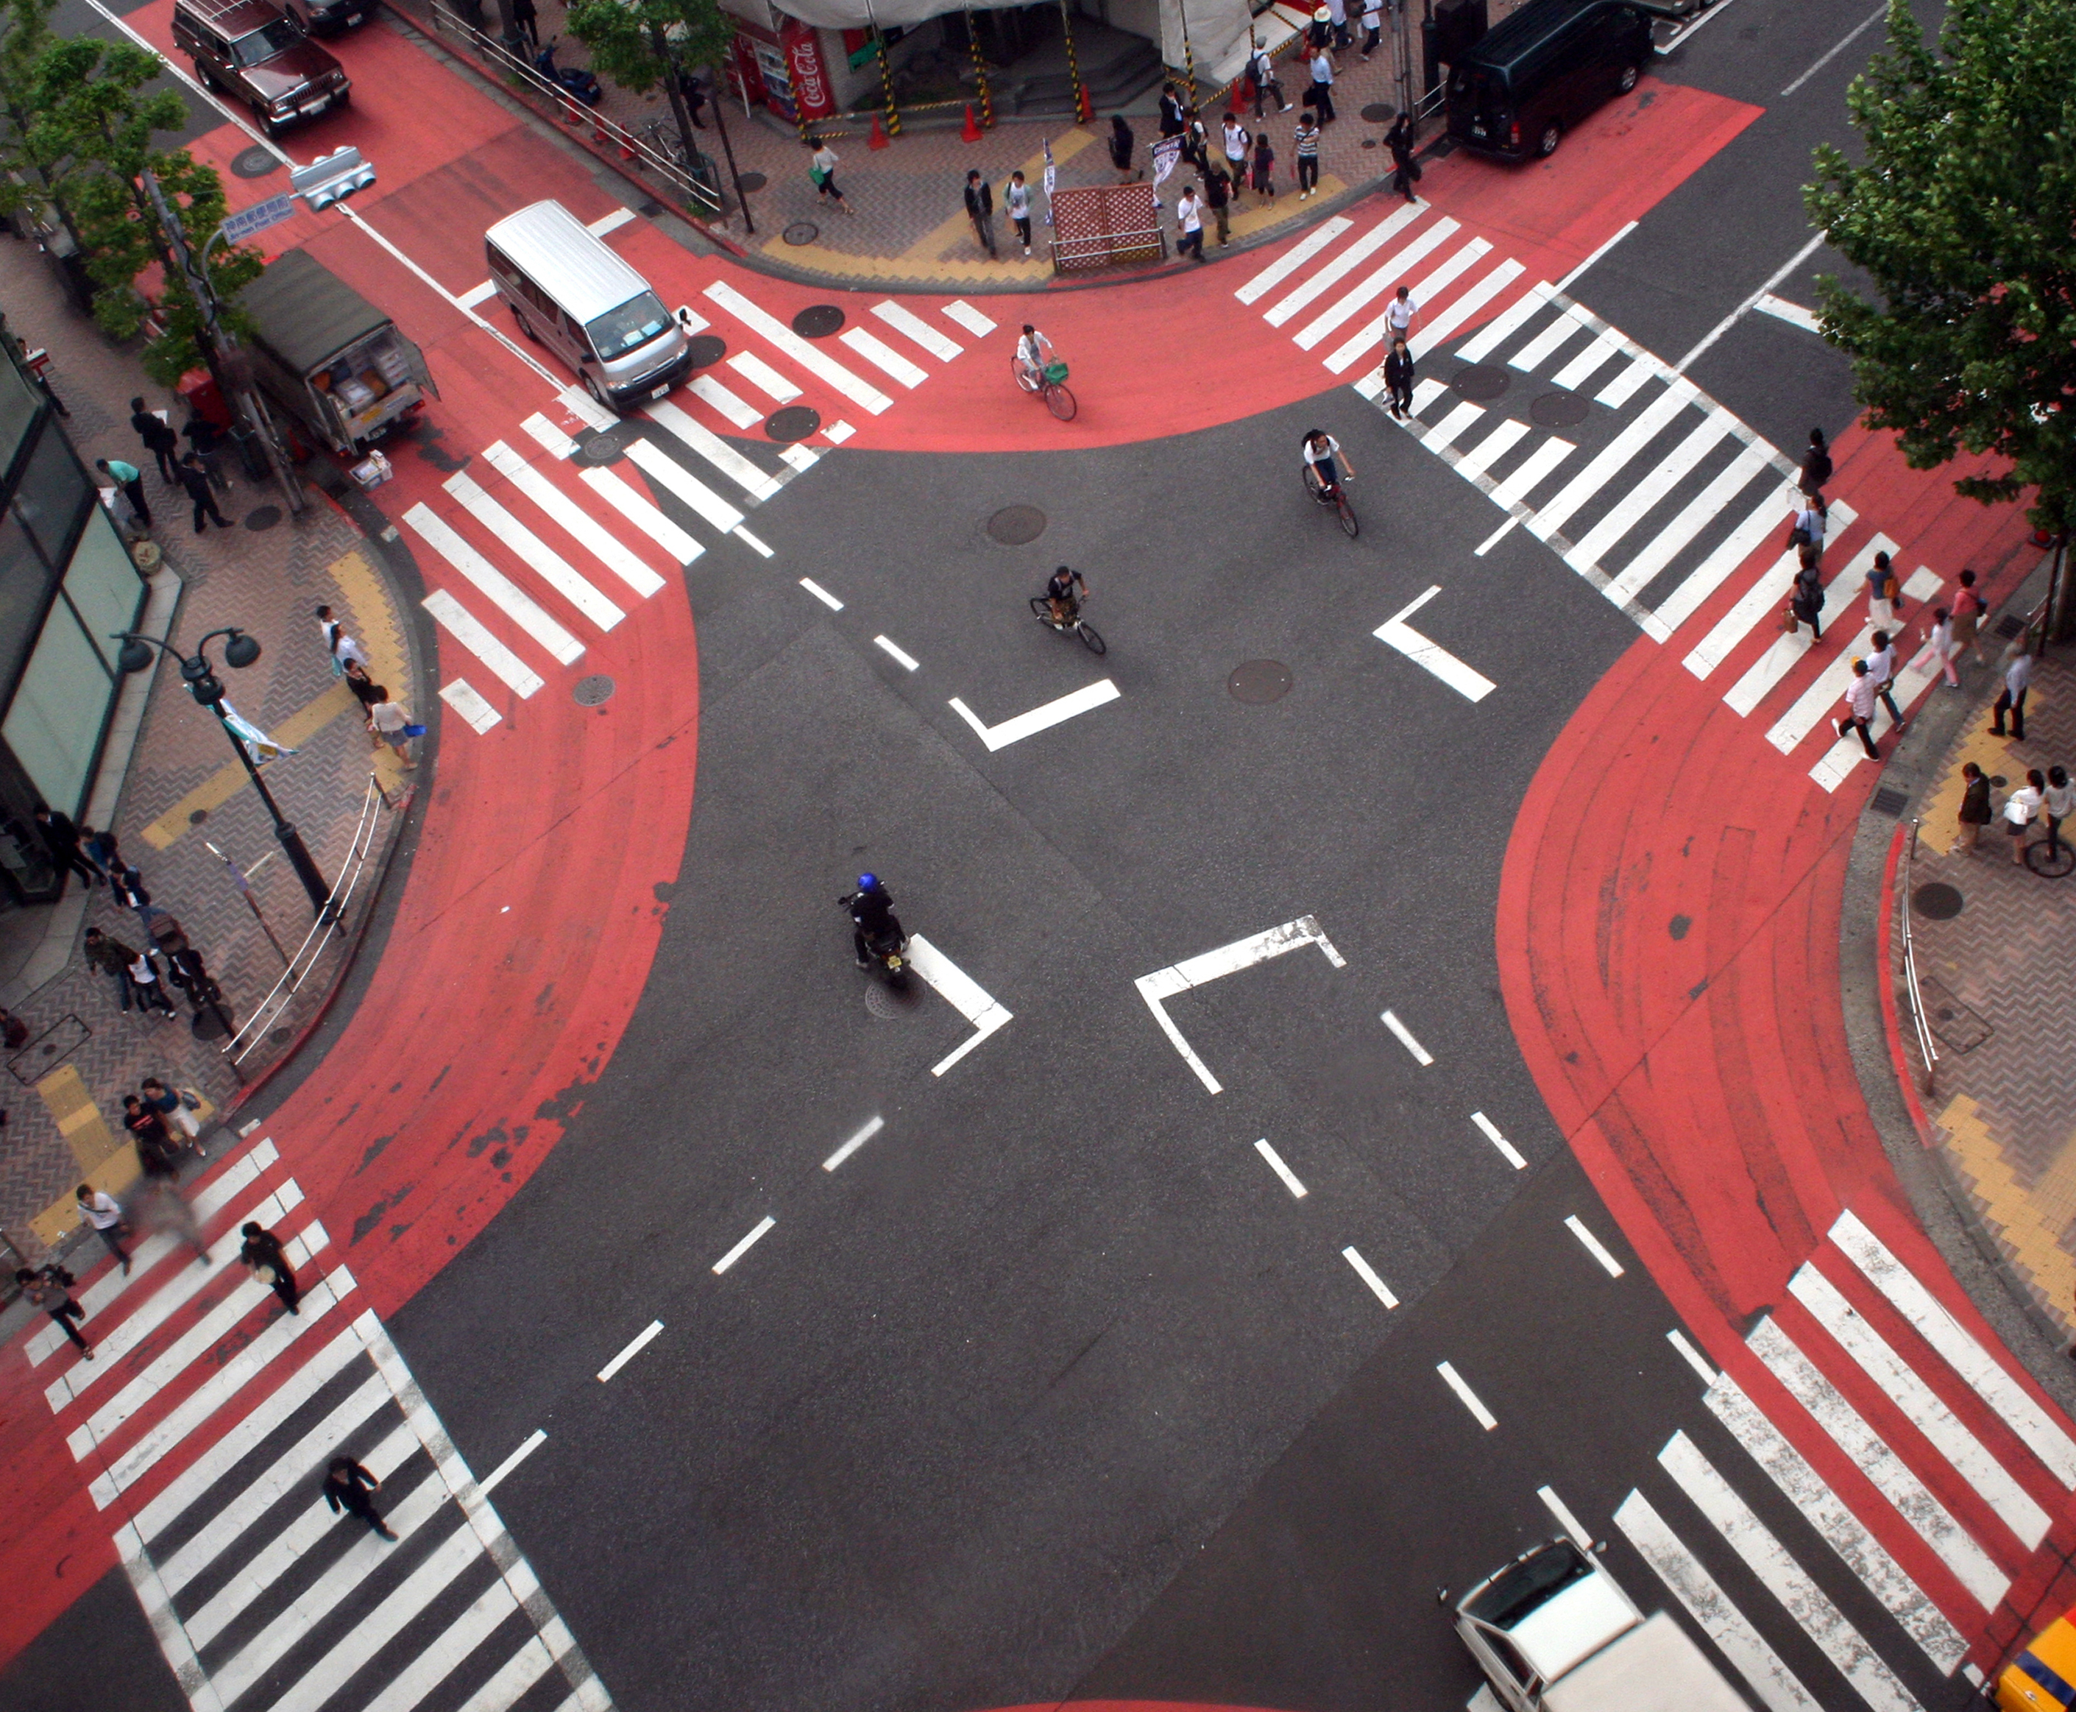
$2.9+ Billion Spent
Annually on Anti-Aging Skincare Products
Breakthroughs
In Skincare
Shift in Power
from Corporations
to Individuals
Rise of
Social Media

Slide 30
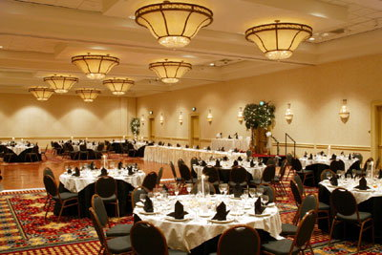

Slide 31
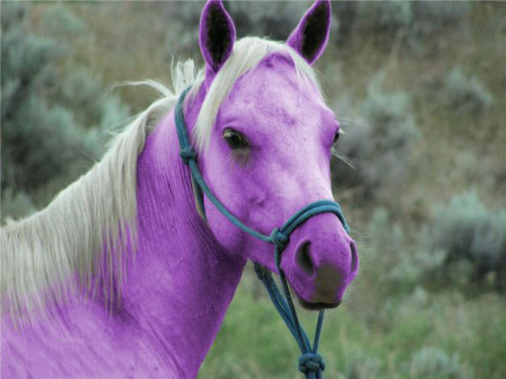

Slide 32
DNA
SOCIAL
COMMERCE
3.0
10 K
HOURS
DISRUPTIVE INNOVATION

Slide 33
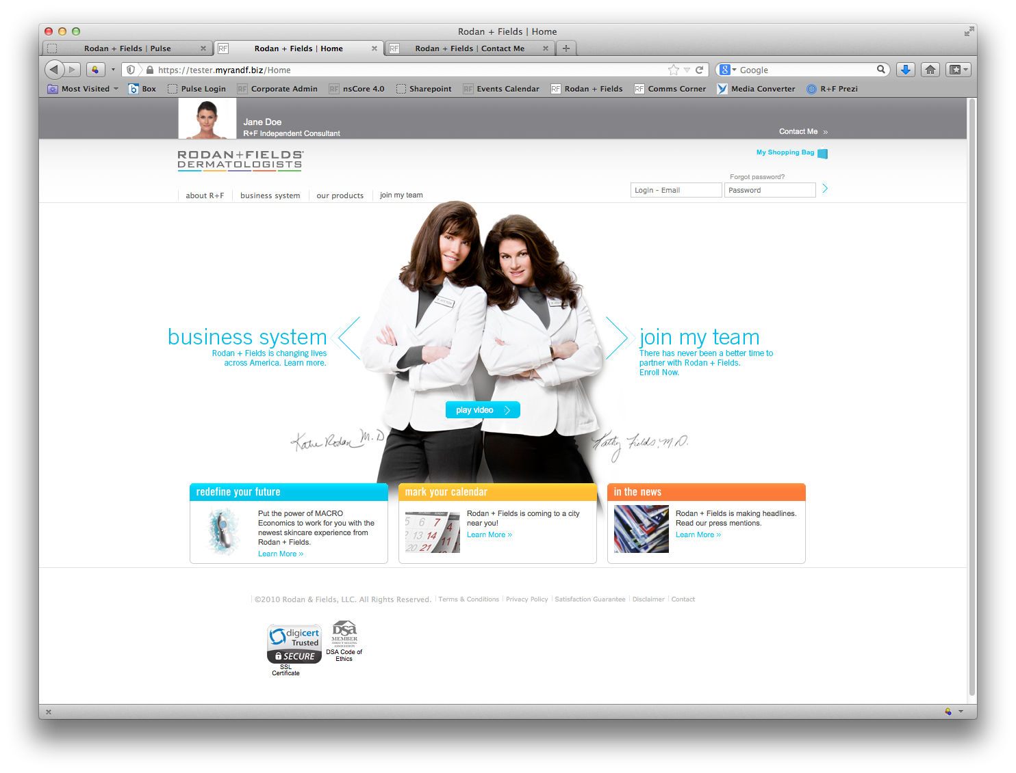

Slide 34
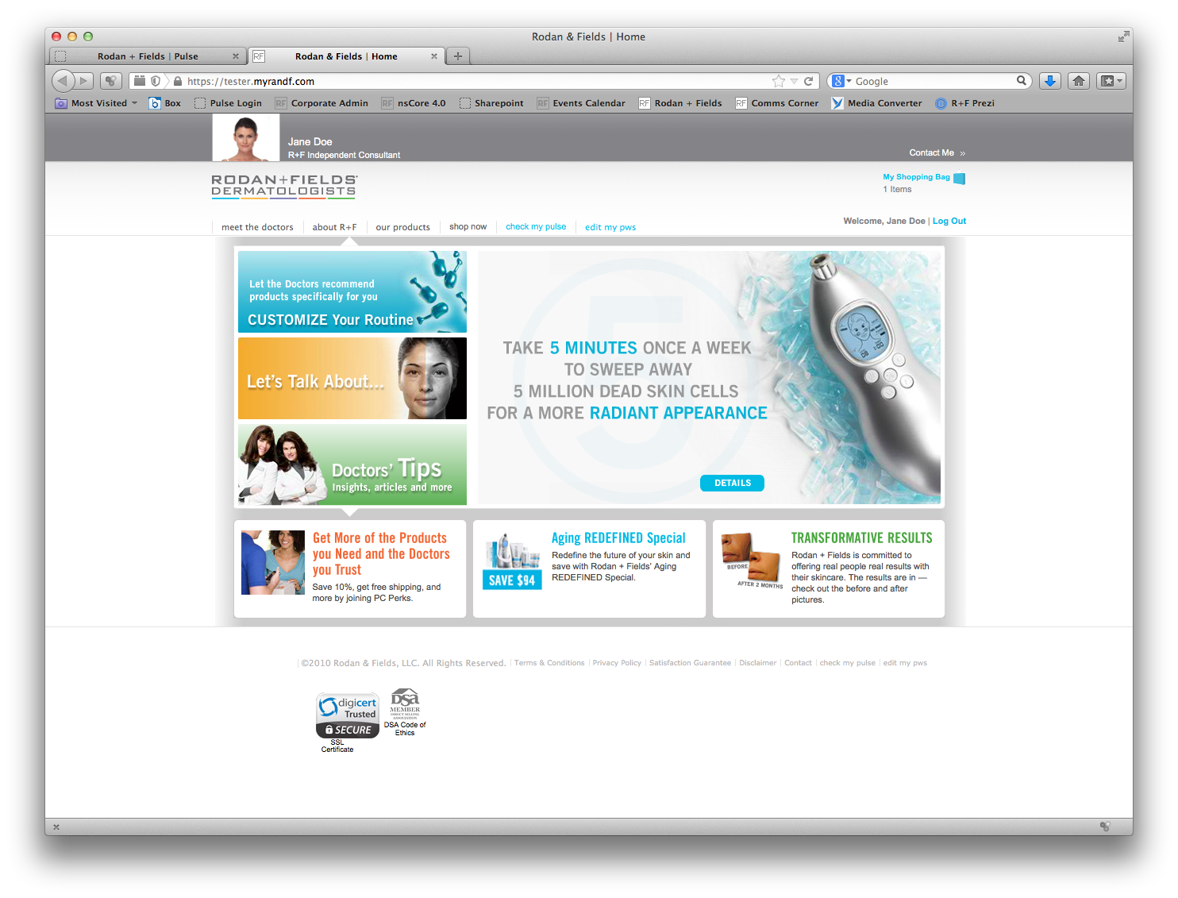

Slide 35
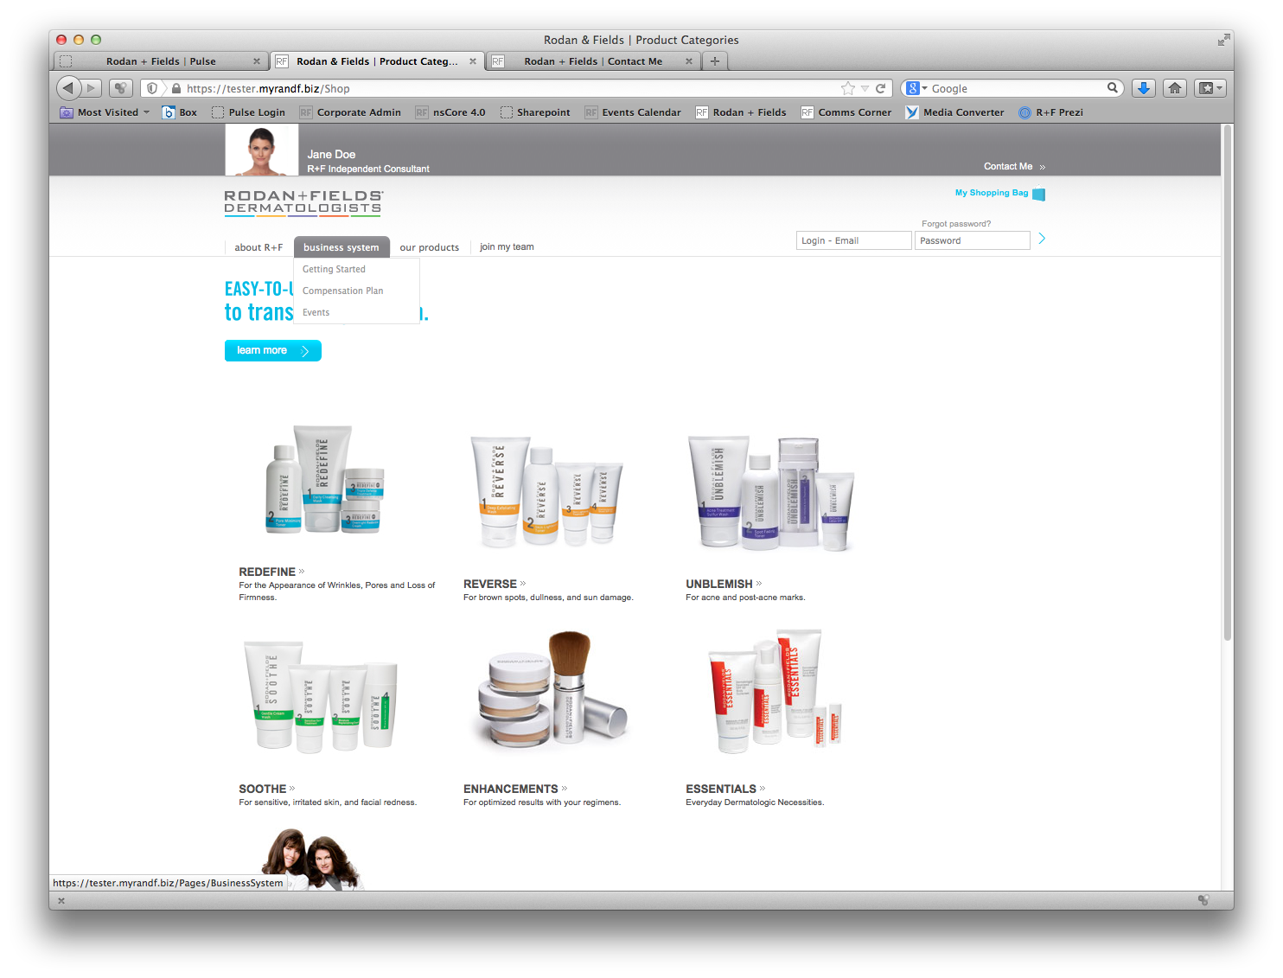

Slide 36
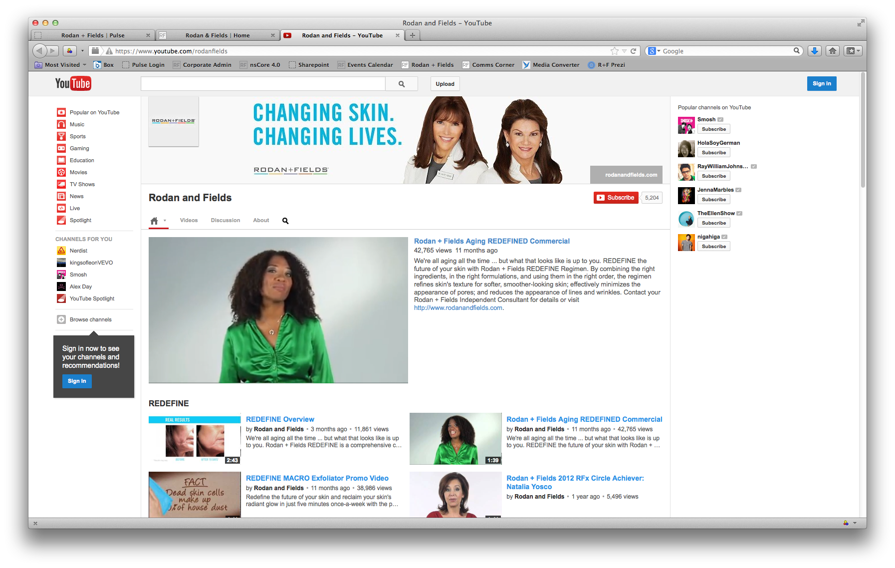
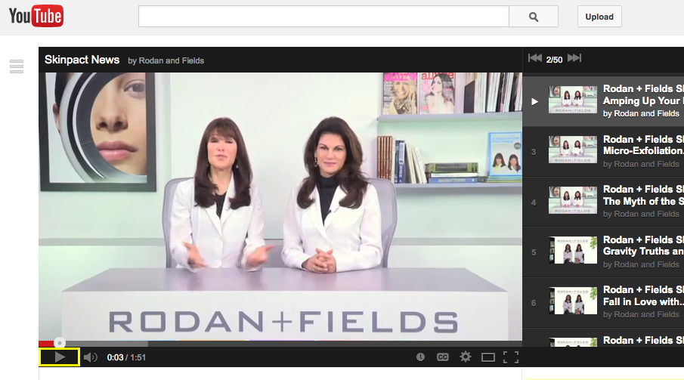
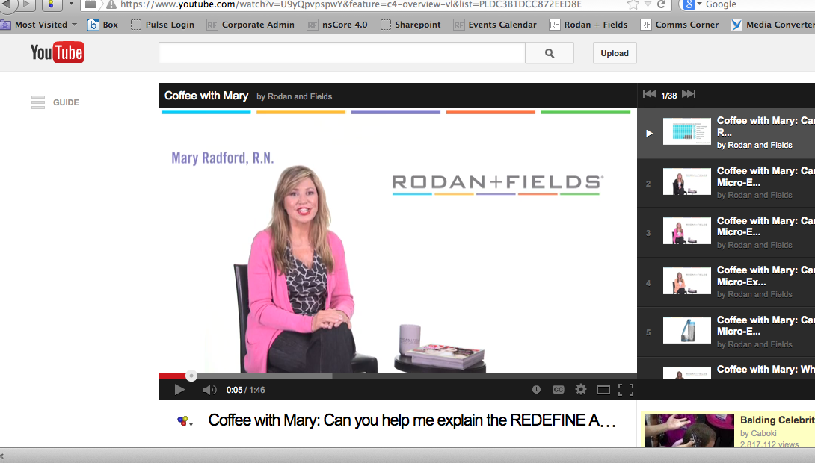

Slide 37
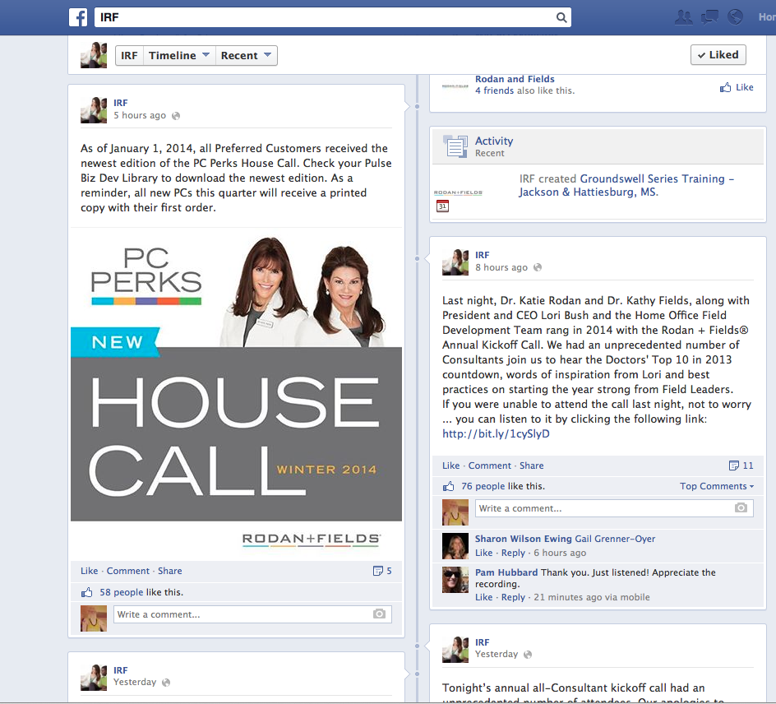


Slide 38


Slide 39


Slide 40


Slide 41


